Slide 1
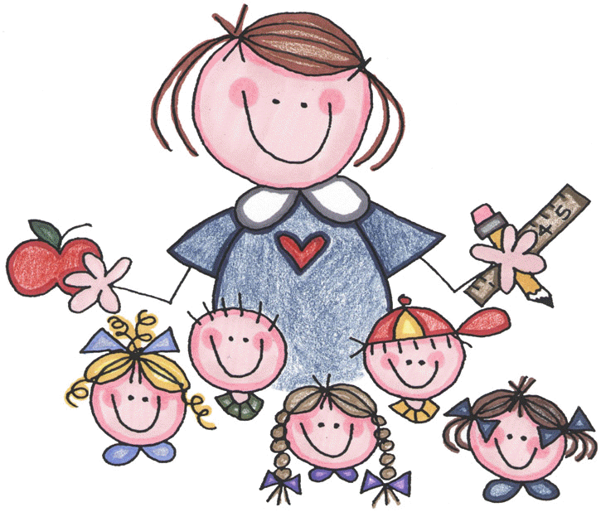
Good evening. Thank you for coming to our Welcome Evening 2019-2020.

Slide 2
We strive to achieve excellence in everything we do by creating an environment which is dynamic, inclusive and collaborative. We want to enable children to reach their full potential.
Our School Vision

Slide 3
Our Core Values-5 Golden Threads
Respect-Others/Ourselves/Environment
Resilience
Responsibility
Resourcefulness
Reflectiveness

Slide 4
Our School Values
Hands and Feet to ourselves at all times/ do not act in a way that endangers others.
Always tell the truth-don’t be afraid to be honest.
Smile and have fun.
Always show kindness towards others.
Always be ready for learning.
Always try your best and have a Growth Mindset.
Never be afraid to make a mistake

Slide 5
Team GB Who is who and what are their roles and responsibilities?
Senior Leadership Team
Mrs Kerrell-Headteacher
Safeguarding Lead/ Pastoral Care/
The Curriculum/ Assessment and French
Mrs Crow-Deputy Headteacher-Year 1/2
Deputy Safeguarding/ KS1/ Maths/ PE and PSHE Leader
Mrs Aldred-Senior Teacher-Year 5/6
Deputy Safeguarding / KS2/ English/ Data Systems

Slide 6
Teaching Team
Mrs Atkinson-Reception/ Year 1
Reception/ Science Lead
Mrs Savage-Year 1 Pixie morning group
Art and Design and Technology Lead
Miss White-Year 3
History/ Geography/ Computing
Miss Kyriacou-Year 4
NQT/ Library
Mrs Williams Year-5/6 (1 Day)
RE/Interventions (Year 5/6)
Mrs Metson (1 ½ days)
Music/Interventions (Year 3/ 4)
Mrs Richardson (1 ½ days)
SENCO

Slide 7
Additional Key Members of our School Community
Our Governing Body
Our Office Staff
Our Caretaker
Our Kitchen Team/ MDA Team
Our PTA-Friends of Bardfield School
All of our team members play a key role in ensuring that children are SAFE, happy, have their emotional needs met and have opportunities for learning in a fun way.

Slide 8
It is so important for your child
that we work together in partnership with you
PARENTS/CARERS
Teachers and Staff
Governors

Slide 9
Safeguarding
Safeguarding your child is our number one priority
What does safeguarding mean?
Who is responsible for it?
How can I safeguard my child?
How can I support the school with safeguarding my child?
Parent Forum Group
Our Safeguarding Governor is
Mr Christian Young.

Slide 10
What will my child be learning this term?
Every term teachers will give out a Curriculum Leaflet so that you can follow what your child is learning
This Autumn Term the Topics are:
Reception: Bears
Year 1 and 2: Fire Fire-The Great Fire of London
Year 3: Stone Age to Iron Age
Year 4: Tudors
Year 5/6: The Greeks
We aim to provide your child with learning opportunities that are rich and engaging. We want your child to be excited about their learning and to be able to link their learning together.

Slide 11
Our School Results 18/19
RECEPTION
Year 1 Phonics

Slide 12
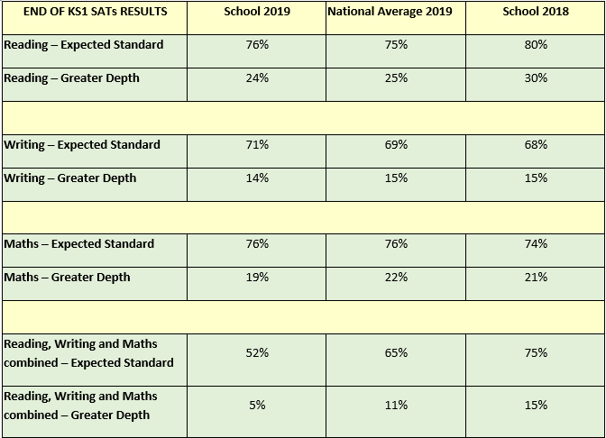
Key Stage One

Slide 13
Key Stage Two

Slide 14
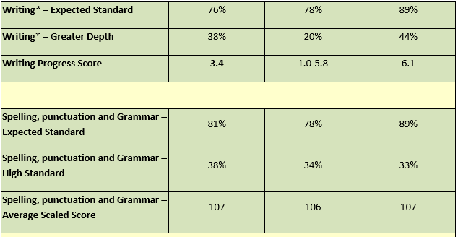
Key Stage Two

Slide 15
Read with your child/ make sure they read for 15 minutes everyday.
Monitor what they are watching on line and limit access to electronic devices so that they sleep and have downtime
Be positive about our school in front of your child. If you have a problem or concern talk to us. Please do not take to Social Media
Make sure your child is on time for school and has what they need so that they do not worry BUT also encourage independence
Make sure that your child does not have periods of absence in term time
Read the newsletter, letters home and use the website as a source of information.
Make sure that they are smart for school in their uniform.
How can I best help/support my child?

Slide 16
THANK YOU FOR YOUR TIME THIS EVENING
We hope you have found this information useful.
Do please read the information in your pack and keep it handy.
We will also upload it to our website along with our results.
Please remember if there is anything further you wish to know you can visit our website or call the office.
Any Questions?

